Slide 1
If you weren’t expected to, would you set targets/goals for your students?
Albert Vas

Slide 2
Target-setting
On your tables:
Discuss your thoughts on target-setting and, if you can, put them under the headings
The Good
The Bad
The Ugly
Amazon.com

Slide 3
The good…. Targets can…
help keep students and teachers focused on what is important
help teachers think critically about how to teach what is important
help motivate students and provide a sense of accomplishment when goals are achieved.
support students to learn how to create their own goals
help identify underperforming students
Adapted from Deci & Ryan, 1985; Locke & Latham, 2002; Martinez (2001); The National Education Performance Monitoring Task force (2000) and Day & Tosey (2011 ) …)

Slide 4
The bad
Potential for generating unhelpful or even harmful comparisons
Students with low targets may work down to their teachers’ low expectations
Difficulties inherent in setting targets that are realistic for a wide range of individuals
Can be employed instrumentally narrowing the varied purposes of learning and reducing engagement
Adapted from Deci & Ryan, 1985; Locke & Latham, 2002; Martinez (2001); The National Education Performance Monitoring Task force (2000) and Day & Tosey (2011 ) …)

Slide 5
The Ugly
What do you think?

Slide 6
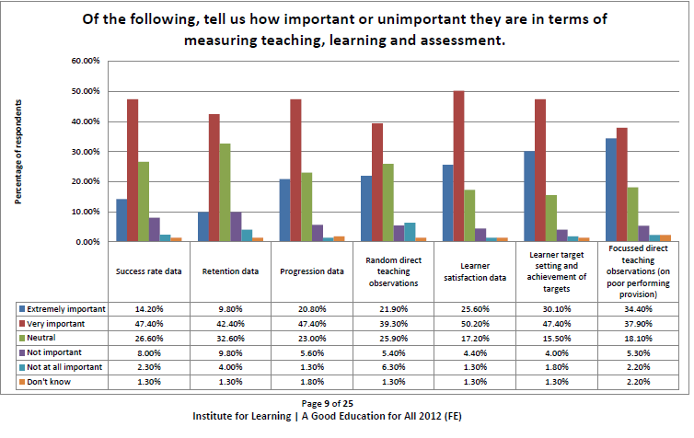

Slide 7
A brief history
Malcolm Knowles, who popularised the concept of andragogy, suggested a number of ways adults learn – in relation to goal-setting possibly the most important is:
Self-directed learning
Where learners can, with or without the help of others, diagnose and assess their learning needs and formulate learning goals.
Malcolm Shepherd Knowles (1913–1997)
http://infed.org/mobi/malcolm-knowles-informal-adult-education-self-direction-and-andragogy/

Slide 8
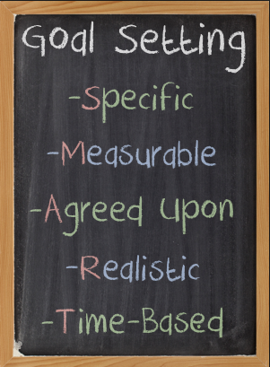
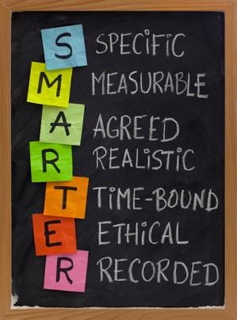
The SMART acronym first appeared in the November 1981 issue of Management Review as a means to improve project management in business.
S – SPECIFIC
M – MEASURABLE AND MEANINGFUL
A – ACTION-FOCUSED
R – RELEVANT
T – TIME DEPENDENT
I – INNOVATIVE
E – EXCITING AT A PERSONAL LEVEL
https://www.projectsmart.co.uk/setting-smarter-goals-in-7-easy-steps.php

Slide 9
What’s the ‘official’ line on target-setting?
Inspectors will evaluate learners’ progress compared with their starting points, based on their rate of learning, acquisition of knowledge, skills and behaviours and whether they have achieved their individualised, challenging targets.
Further education and skills inspection handbook (Ofsted, 2018)
Throughout the time spent on their learning programmes, learners and groups of learners make substantial and sustained progress towards their agreed learning goals
Effective practice in the delivery and teaching of English and Mathematics to 16-18 year olds (DfE, 2017)

Slide 10
Effective use of setting goals
…and what we can realistically do
On your tables:
Discuss any strategies you have come across or used that have been successful/unsuccessful for target-setting in your teaching practice

Slide 11
What we can do to engage students in goal-setting
Setting the scene – why are they important?
Consider:
Providing personal examples where you have set goals for yourself
Asking the students about a goal that they have had and what they did to achieve it
Asking the students for their input into how they can achieve their current educational/mathematics goals
Asking when they can realistically work on these

Slide 12
Teachers’ and students’ perspective
Some similarities
Can support learning through discussion of areas to improve
Improve focus and effective use of time
Importance of communication between teacher and student regarding strengths and weaknesses (reviewing targets)
Importance of relationship between teachers and student

Slide 13
Teachers’ perspective
Most effective when created from marked work
Important to relate to everyday life/future career
Use MathsWatch/BKSB to create, identify and track targets and for students to see progress
Students’ perspective
Teachers can use ‘strong’ students to help ‘weaker’ ones to reach their goals
Students more likely to ask for help if they know that their teachers are involved in their learning
Reaffirms students confidence in their strengths
Students may struggle to meet deadlines/achieve targets which increases stress

Slide 14
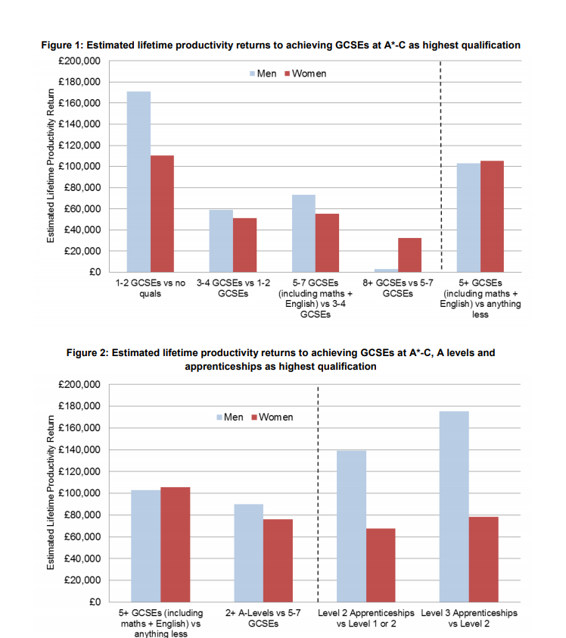
It shows achieving 5 A* to C GCSE grades, including the vital English and maths subjects, adds £80,000 to a student’s earnings over their lifetime.
A further £60,000 is added to their wages if they go on to achieve at least 2 A levels, highlighting the economic value of the increased knowledge, confidence and employability that arises from success in school.
Department for Education (2014)

Slide 15
How important are GCSE grades?
GCSE results form an important part of the academic journey and results can impact on:
Acceptance of future qualifications
Eligibility for a university course
The universities that can be applied for
Future career prospects
https://university.which.co.uk/advice/gcse-choices-university/how-important-are-my-gcse-grades

Slide 16
TASK
In groups of three, review the suggested goal-setting strategies and consider how they can be used or adapted to support your students.

Slide 17
Key points
Create engagement in the goal by making it meaningful to the individual
Discussion – what makes them tick?
Making it easier for students – how and when do they work best?
Goals set teachers do not have the same level of student ownership
Should be reviewed frequently by both teacher and student
Keep goals quite specific and ‘nested’ within bigger picture
You’re probably doing it without knowing

