Slide 1
T Levels – an NCFE Overview Dawn Norman NCFE Account Executive
Notes:
NCFE has ben providing products and services to the education sector for over 170 years.
I’ve been part of that journey for 13 years now and even in that time the portfolio has grown and developed exponentially.
Our study programme provision provides 16-19 learners with a structured and challenging learning experience which supports their development and progression, whether that’s onto higher education or into industry.
The merger with CACHE has strengthened our proposition within the market and we have some fantastic support available to the many centres we work with nationally and internationally.

Slide 2
T Levels

Slide 3
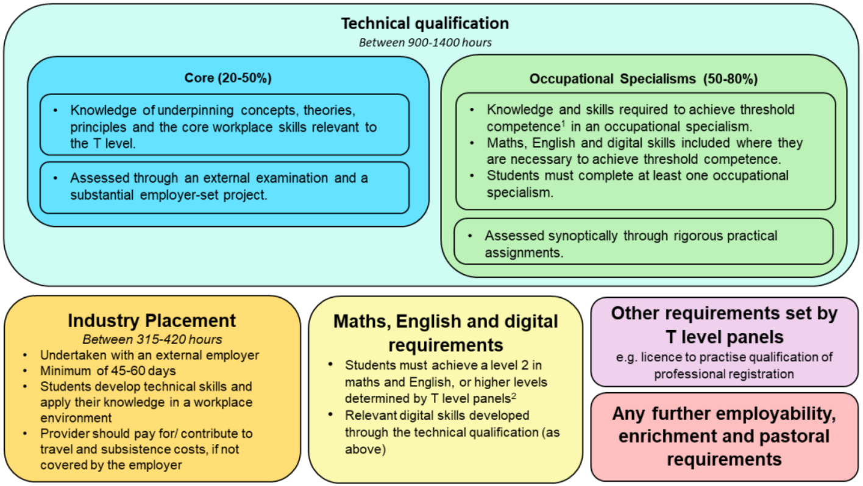
What is a T Level?
Notes:
So does everyone in the room know what a T Level is?
From 31 January 2019 the Institute for Apprenticeships took responsibility for technical education from the DfE and are now known as IfATE – the Institute for Apprenticships and Technical Education.
The T Level programme is split between them:
IfATE lead on the technical qualification
DfE lead on the industry placements as well as English, maths and digital components
The Technical Qualification has 2 distinct sections – the Core and the Occupational Specialist component.
The Core focuses on the knowledge any learner in this route would need to be able to progress in this sector. So it’s knowledge which is relevant to any of the Occupational Specialist routes. The Core is assessed with external exams as well as an Employer Set Project.
The Employer Set project is an piece of external assessment that is set and marked by us as the Awarding Organisation. It uses current real life problems which a student provides a solution to.
The Occupational Specialist component focuses on the skills of a particular occupation, Education and Childcare has 3 – they are:
Early Years and Childcare,
Assisting Teaching and
Supporting FE and HE mentoring
This looks at the skills a student needs to have to be threshold competent in that sector or job role. Again, as much as possible of this component is assessed externally through practical assignments which are set and marked by us.
In addition to the Technical Qualification, students will complete a substantial Industry Placement, and maths, English and digital qualifications at level 2 – if they don’t already hold these

Slide 4
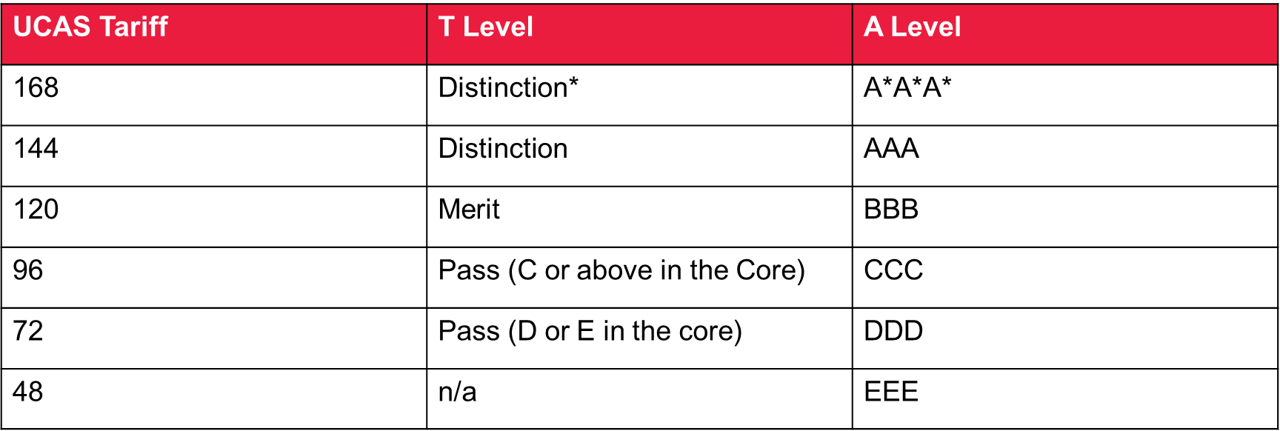
T Levels – UCAS allocation
Notes:
Worth also highlighting UCAS as a lot of learners will want to progress to university.
Each T level programme has been allocated a number of UCAS points.
This is for the programme as a whole – rather than being broken down by the individual components.
The UCAS points are comparable with other level 3 provision.

Slide 5
Childcare and Education TQ – Content
Core Elements (Year 1)
Wider Context | Working with Others
Child Development | English as an Additional Language
Supporting Education | Parents, Families and Carers
Safeguarding, Health and Safety and Wellbeing | Special Educational Needs and Disability
Behaviour | Reflective Practice
Observation and Assessment | Equality and Diversity
Occupational Specialism (Year 2)
1. Early Years education and childcare
2. Assisting teaching
3. Supporting and mentoring students in Further and Higher Education
Notes:
This is the first of our T Level developments and the qual spec went live yesterday.
We’re putting on many training events and webinars for the early adopters of this T Level before delivery begins in September.
This will also happen with our future developments as we want to support teaching staff as much as possible with regard to sharing best practice for delivery, and teaching and learning resources.

Slide 6
And…

Slide 7
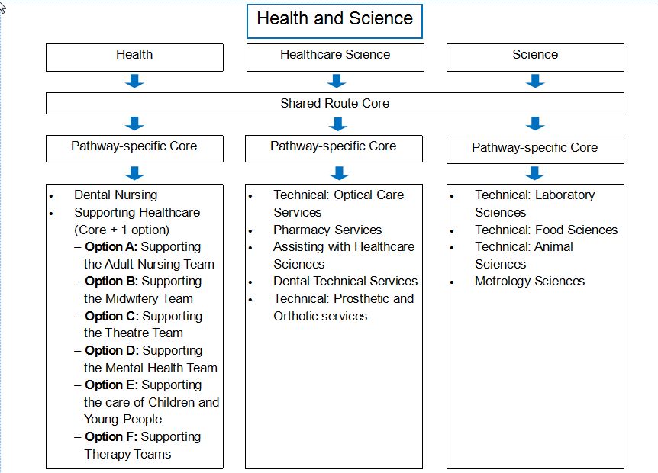
Health and Science
Notes:
The occupational specialisms are all set. Here is the information we were given to explain the set up.
Health and Science T Level has 3 routes:
Health
Healthcare Science
Science
All learners must complete a shared core element in year one. They also have to complete a route core element depending on which route they choose.
Then in year 2 they can specialise. The occupational specialisms are:

Slide 8
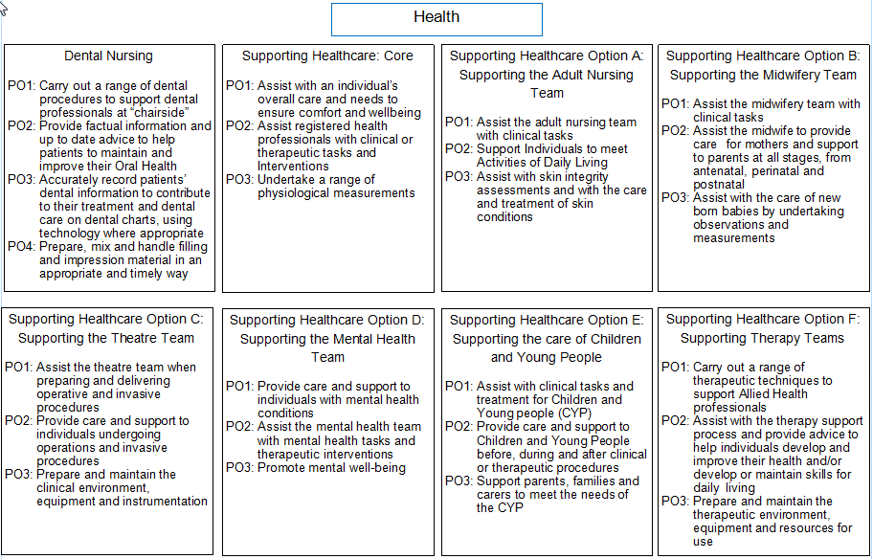
Health
Notes:
Health:
Dental Nursing
Supporting the adult nursing team
Supporting the midwifery team
Supporting the theatre team
Supporting the mental health team
Supporting the care of children and young people
Supporting therapy teams

Slide 9
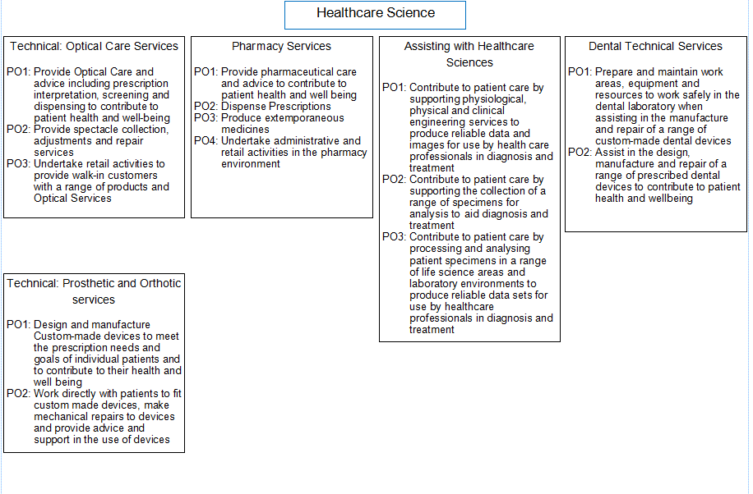
Healthcare Science
Notes:
Healthcare Science:
Optical Care Services
Pharmacy Services
Assisting with Healthcare Sciences
Dental Technical Services
Prosthetic and Orthotic Services

Slide 10
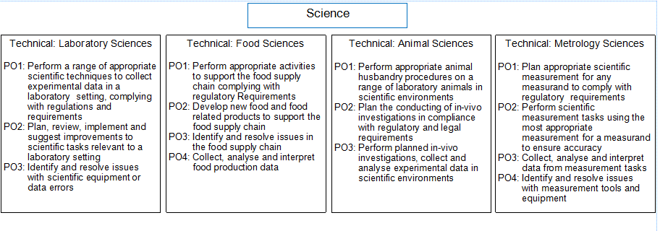
Science
Notes:
Science:
Technical: Laboratory Sciences
Technical: Food Sciences
Technical: Animal Science
Technical: Metrology Sciences

Slide 11
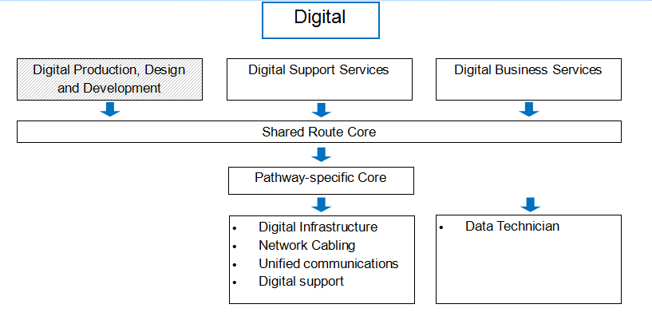
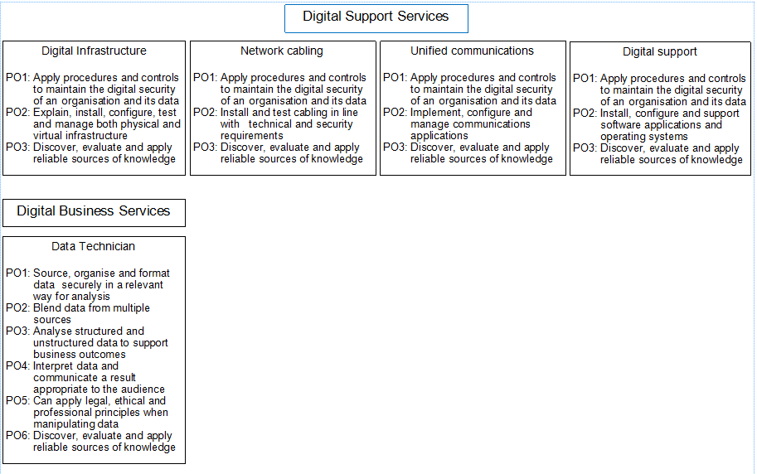
Digital/ Digital Support Services
Notes:
Just for reference – please mention within your centres if you know the digital person and you’re welcome to give them my contact details.

Slide 12
Student profile
Student profiles will gradually begin to change from 2022 with T Levels, A Levels or an Apprenticeship becoming the norm for young learners.
All T Level students will have been exposed to English, maths and digital skills in context to their core study and occupational specialism.
They will have been externally assessed through controlled supervision including an Employer Led Project.
Days in industry are inherent to all T Levels.
Notes:
Key messages and worth mentioning that student profiles will change:
A Levels, T Levels and Apprenticeships are the future of education
English, maths and now digital will be contextualised to the core study and occupational specialism
External assessment through controlled supervision and the employer led project
And the work placement hours may increase for T Levels
In childcare they won’t see too much of a change, but for other curriculum areas, this will be a huge difference in their planning as the industry placement we anticipate will be longer.

Slide 13
What could a T Level student study at University?
Childhood Education Studies BA
Childhood Studies BA
Children Youth and Education Studies BA
Early Childhood Development and Learning BA
Early Childhood Studies BA
Education BA
Education Studies BA
Primary Education with QTS
Level 4 Certificate in Post-14 Education and Training
Working with Children, Young People and Families BA
Notes:
With delivery beginning in September 2020, we are working to engage with HE institutions across the country to raise awareness of the T Level agenda. I ask you to help us by spreading the word and any queries are welcome.
We need to work with HE to ensure we have variety of progression routes from the Childcare and Education T Level.
We have suggested degree routes but we would love to work more closely with you to make sure we’re fully aware of your degree provision requirements.
We have a stakeholder team that can support with this and it’s their very job to engage with universities nationally, strengthen relationships and raise awareness.
Recent findings indicate that many Universities don’t know what T Levels are so we need to change this.
It’s worth noting that T Levels are a cross party Government initiative so whichever are in power, T Levels are set to remain.

Slide 14
Notes:
Recently UCB delivered a presentation at NCFE networking event stating that:
- learners using the NCFE Level 3 route feeds very nicely into HE progression.
It’s great to know we have the endorsement of UCB.
I would be keen to also liaise with local universities to talk through T levels for the future.

Slide 15
Teaching the T Event- London 24th March 2020
Our full-day training event is aimed at educators, assessors, and practitioners who are preparing to deliver the new T Level TQ Education and Childcare: Education. This is a great opportunity to meet subject experts, get your questions answered, and expand your knowledge and understanding of the qualification.
This event will run from 9.30am to 4.30pm, and will include:
T Level overview and development update
Qualification content and requirements
Programme sequencing and delivery planning
Assessments summary and sample walk-through
Learning technologies and resources
Notes:
Teaching the T event in London bookable via the qual hub.
This event is for waive1 and 2 providers only at this moment in time.
Support will be provided and information coming soon to assist with on boarding customers for getting ready to deliver.

Slide 16
Resources
Live and in development
Notes:
I wanted to give you some updates on our live resources and some very exciting resources that are currently in development and being tested by some of our centres.

Slide 17
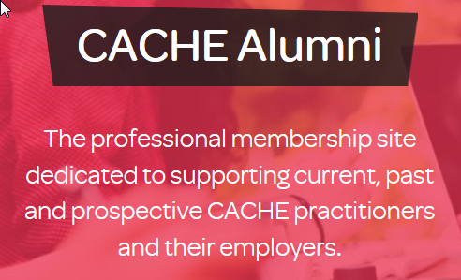
Resources, innovation and news updates
Notes:
We’re always striving to stay ahead of the curve and our innovation team are developing a number of exciting new digital aids to make learning more interactive and interesting for your learners and indeed the staff!
Our PregnancyVue App is a virtual reality (VR) experience that helps learners and parents understand child development from conception to birth.
The app quite literally brings learning to life as you see the child’s growth and you hear how their body evolves and changes over a term of nine months.
The app works on a phone as well in 2d, so it’s not VR, but it’s the same content and it can be downloaded for free from android app store and ios app store. We have also developed a lesson plan that Janet king and Darlington College has put together and that can be downloaded for free from the same website above.
In addition to this we have CACHE news updates and CACHE Alumni whereby you can receive the most up to date sector news and be a part of a professional membership site.
The QualHub is a subsite that holds all information on every qualification under both NCFE and CACHE branded qualifications. Here you can access our Portal of resources, delivery support and policy documents as well as gain approval for qualifications.
It also hosts our ‘Routes to Success’ curriculum maps that you can either print or order from us. These are particularly good to give out to staff, learners and parents to illustrate career detinations.
They illustrate the path learners can follow with our qualifications, and provides key details of each qualification.
(Reference only re PregnancyVue: Customers will need to buy the headset – Oculus Go is the only one it works on at the minute, but we are looking to upgrade it to make it work on Oculus Quest as well.
You can buy the headsets from oculus, amazon, argos.
I know some of our colleges have used the NCOP National Collaborative Outreach Programme to apply for funding
Once they have the headset, they can download the app for free from the oculus store directly or they can go on our website here (but that will send them to the app store): https://www.cache.org.uk/pregnancyvue/education)

Slide 18
Notes:
The ‘My T’ interface will look something like this

Slide 19
Design principles
Supporting development of the skills learners need to progress
Online and offline learning
Desktop and mobile – making use of the technology learners have in their pocket
Covers all aspects from decision making, delivery and continued professional development of the learner
Supports teaching staff to deliver the T-Level
Supports teaching staff to develop their skills.

Slide 20
GoCareer
A Career Guidance and Work Placement management tool
For learners – FREE and available pre-enrolment
Learner CV and career planning tools
Careers Info, Diagnostics and Job Profiles
Location tracking and push notifications when near opportunities
Local, regional and national employers of interest
Progression pathways
For Centres
Learner placement matching
Placement tracking
Dashboard and employer feedback facility
Notes:
USP- Placement tracking and dashboard to evidence completion of work placement and gain employer feedback.
Excellent tool for work placement officers and tutors as it also covers safeguarding of learners on placement, identifies if they are not attending
Administration levels for centre admin, tutor, employer student
Will be available via PC and downloadable app to phone or tablet device.

Slide 21
Platform One
E-learning platform (Moodle)housing professionally developed and engaging blended learning materials:
My Profile
My Course
Modules include Digital, Study Skills, Employability, PSHE, sector-specific blended learning modules/lessons.
T level Core content blended learning modules/lessons.
Notes:
Moodle platform can house all of the learning resources to support delivery of the T levels. Parents can access and view how the learner is progressing.
Student and tutor forums to support independent learning.
Please note the external assessments will not be held on this platform
Let’s have a look at the resources that will be housed on the platform…

Slide 22
Learning Resources
A full suite of blended learning resources designed to support tutors to effectively deliver all the elements of the T Level in Education and Childcare.
Our resources will include:
Blended learning modules for use in and out of the classroom
Virtual Reality resources and apps
Schemes of Work and Lesson plans
Text book
Each lesson is designed following active learning principles and includes:
A range of classroom based activities
Independent learning and extension tasks
Reflection activities
Notes:
Full classroom packs including lesson plans, activities and e-learning modules to support tutors to deliver and teach the T level
We have centres trialling these at the moment so thank you to anyone in the room who’s supporting us in this, we really do value your input.

Slide 23
Skills Forward
Digital learning platform providing diagnostics tool and e-learning resources to support delivery and assessment in:
Maths (GCSE and Functional Skills)
English (GCSE and Functional Skills)
Digital Skills
Study skills
Employability skills
Notes:
Skills Forward are a partner organisation that also sits under the NCFE family umbrella.
They provide study skills diagnostics specifically for T levels. Employability diagnostic linked to the Gatsby benchmarks

Slide 24
Peer Tutor
Secure online platform and App that allows verified mentors to deliver lesson content created by expert teachers
Peer to peer mentoring
Employer to learner mentoring
Tutor to learner mentoring
Built in safeguards
Benefits
Drives up achievement for learners of all abilities
Gives enrichment opportunity for advanced learners
Notes:
Live lessons in English and maths for learners who require extra support or who are working towards their Level 2.

Slide 25
Collaboration

Slide 26
Collaborative opportunities
Becoming a stakeholder
Acorn community
Technical Education Advisory Board (TEABs)
Specific HEI engagement projects
co-creation of progression case studies
progression to Level 6 top up degree
learner progression / tutor events
Notes:
As an AO it’s important that our qualifications are fit for purpose, providing people with the skills they need to succeed, and employers with a qualified, job ready workforce. We work collaboratively with a wide range of experts to ensure our qualifications and services meet the needs of industry, and help close workforce skills gaps.
Our stakeholder contacts feed into our qualification developments and can get involved in the following way:
feedback on a new qualification idea
endorse qualifications and promote your University through the use of your logo on our material
attend qualification scoping days
review unit content to check for relevance and accuracy to industry / degree progression opportunities
Acorn Community is a secure online platform that supports the creation of ideas and shapes the design of our qualifications, products and services. It can provide you with an efficient and effective way of communicating with other stakeholders on relevant topics
external platform with secure login
network with all stakeholder types, as listed above
chance to view, comment and submit ideas on a range of projects across multiple sectors
receive a certificate of contribution
current £50 incentive for valuable contribution
fulfil your corporate social responsibility (CSR)
can contribute to your CPD
TEABs – a group of FE providers, HEIs, employers and professional bodies. The overarching purpose of the advisory board is to understand and plan for the emerging sector specific impacts of Technical Education policy on education and industry, ensuring promotion of rewarding career pathways. Due to the impact, the focus has been T Levels. As mention there are several T Level sector areas so we have/will build TEAB’s for each area.
Alongside collaborative working on qualification developments, we are working with HEI’s in the following ways:
co-creation of case studies; promoting acceptance of our Level 3 qualifications and degree provision on offer
we are creating a progression pathway from our Level 5 CACHE provision to step onto a top up Level 6 degree
co-creation of learner progression events to broaden their HE knowledge/understanding and raise aspiration, tutor events to upskill on progression and good practice for sector. Both provide an opportunity to showcase the university to a relevant and captured audience
Above is just a snap shot, if you want more nformation about collaborative opportunities or to have a chat about how we could work together please let us know.

Slide 27
Contact
Dawn Norman
Account Executive
dawn.norman@cache.org.uk
07824 346686
Notes:
So if you think of anything you need, or have any further questions following today, you’re welcome to direct them to me.
We’re all learning together, this is a new wave of development and a significant change for post 16 education so we’re looking forward to working with you.
Thank you very much

