Slide 1
Notes:
Hello my name is…. and my role at CACHE is the…… In this webinar we will look at the early years apprenticeship landscape. Let’s start with a brief overview and update

Slide 2
Our vision
We believe that humans have unlimited potential to make the world a better place. We believe that learning is the key to unlocking this potential and enabling people to have the most fulfilling life that they can.
We also believe that everybody has the right to access high quality learning, throughout their life.
We’re inspired by our core purpose, which is; ‘to promote and advance learning’.

Slide 3
Our vision
Learner first always – Apprenticeship Centric Approach
Integrity / Values – long term profitable relationships
World Class Customer Service – meaningful SLA’s & KPI’S
Flexible, when we can be – Client Relationship Managers
Customer Support Programme to improve experience and outcomes
Truly independent and objective
Directly employed sector/occupational specialists
Platform to manage, track and report on progress
Notes:
Just talk through slides and handover to Leo who will discuss the End Point Assessment in more detail. Thank you

Slide 4
Our EPA offer – Health & Care
Adult Care Worker
Lead Adult Care Worker
Healthcare Support Worker
Senior Health Care Support Worker
Healthcare Assistant Practitioner
Nursing Associate
Dental Nurse
Dental Practice Manager
Notes:
Just talk through slides and handover to Leo who will discuss the End Point Assessment in more detail. Thank you

Slide 5
Our EPA offer – Childcare & Education & Social Care
Teaching Assistant
Children, Young People & Families Practitioner
Children, Young People & Families Manager
Early Years Educator
Notes:
Just talk through slides and handover to Leo who will discuss the End Point Assessment in more detail. Thank you

Slide 6
Our EPA offer – Business & Management
Customer Service Practitioner
Customer Service Specialist
Business Administrator
Team Leader / Supervisor
Operations / Departmental Manager
Associate Project Manager
Notes:
Just talk through slides and handover to Leo who will discuss the End Point Assessment in more detail. Thank you

Slide 7
Our Guidance Documents
Standard specific guidance documents
Covering guidance on completing the EPA
Grading information for each assessment type
Templates for apprentice portfolios
Mapping of relevant qualifications
Notes:
Just talk through slides and handover to Leo who will discuss the End Point Assessment in more detail. Thank you

Slide 8
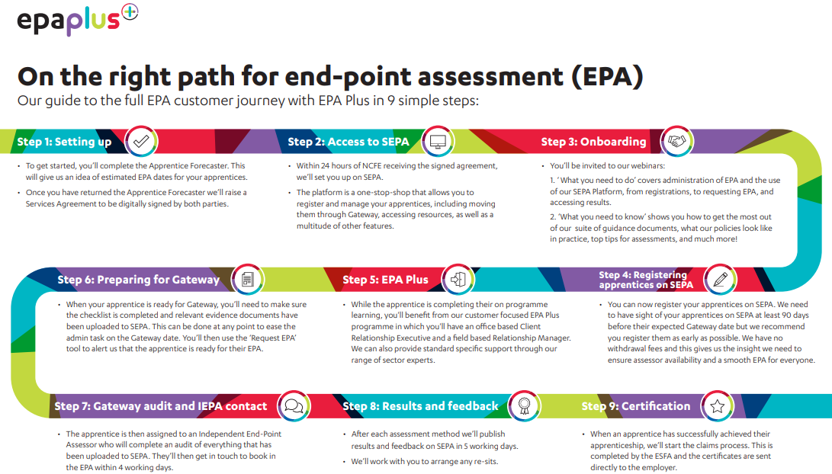
Notes:
Just talk through slides and handover to Leo who will discuss the End Point Assessment in more detail. Thank you

Slide 9
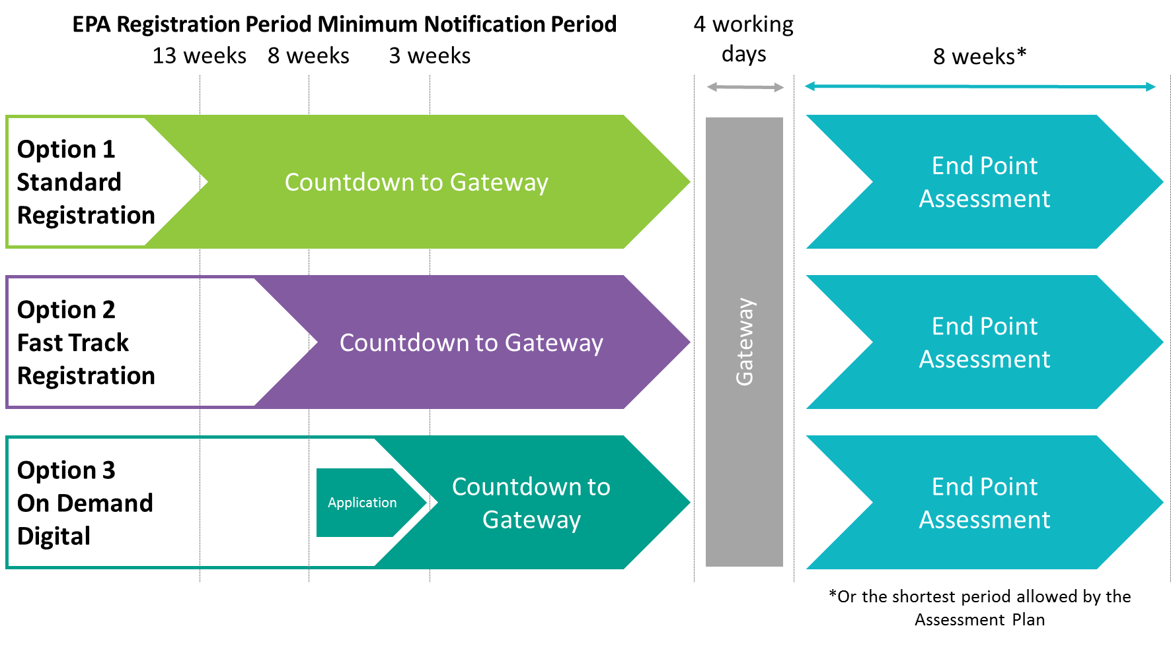
Key processes

Slide 10
Get in touch
epa@ncfe.org.uk
0191 240 8950
Notes:
Just talk through slides and handover to Leo who will discuss the End Point Assessment in more detail. Thank you

